Slide 1

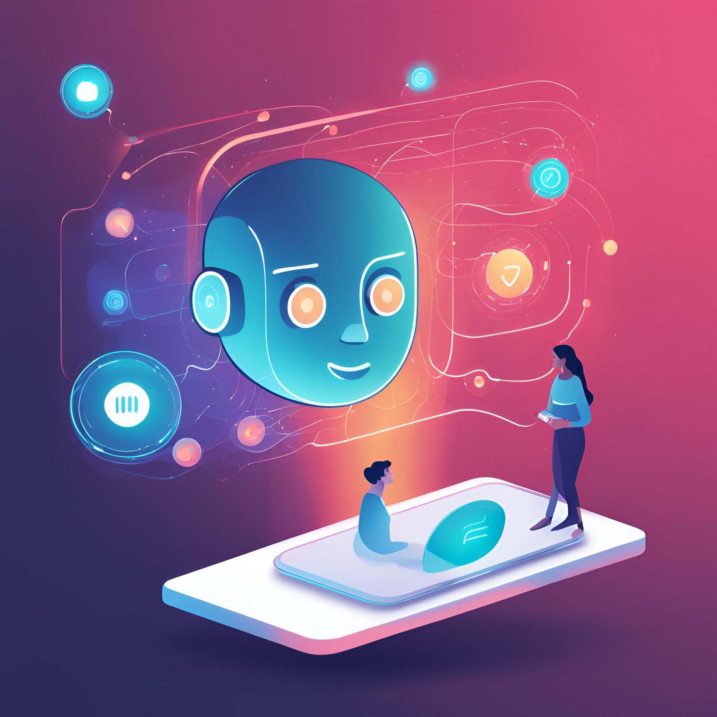

MENTAL HEALTH CHATBOT
Unathi Sibanda
Providing Supportive Conversations through AI

Slide 2

03
PROBLEM STATEMENT
LIST OF CONTENT
PRESENTATION
04
SOLUTION OVERVIEW
08
05
FUTURE DEVELOPMENT
KEY FEATURE
09
DEMONSTRATION
06
HOW IT WORK
10
IMPACT & CONCLUSION
07
TECHNOLOGY STACK

Slide 3




PROBLEM STATEMENT
MENTAL HEALTH CRISIS
Globally, people face increasing levels of stress, anxiety, and depression.
NEED FOR ACCESSIBLE SUPPORT:
Many individuals may hesitate to seek help, especially if resources are limited or unavailable.
OPPORTUNITY FOR EARLY INTERVENTION

Slide 4
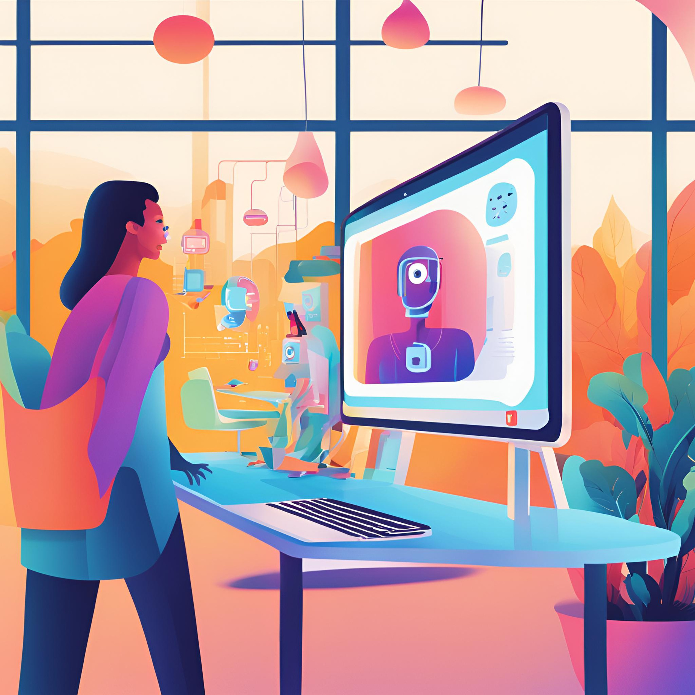

SOLUTION OVERVIEW
INTRODUCING THE MENTAL HEALTH CHATBOT
An empathetic, conversational AI designed to provide supportive dialogue and guidance for users experiencing stress, anxiety, or sadness.
GOAL
To encourage users to open up, reduce feelings of isolation, and offer gentle suggestions or resources for self-care.

Slide 5


PERSONALIZED INTERACTION
The chatbot greets each user by name, creating a friendly and inviting experience.
TARGETED RESPONSES
The bot detects keywords (e.g., "anxiety," "depression") and provides tailored replies to address those feelings.
FOLLOW-UP QUESTIONS
KEY FEATURES
Allows for more in-depth conversations by asking the user additional questions based on their responses.
USER GUIDANCE
Offers suggestions, such as breathing exercises, and encourages users to talk to friends or family if needed.

Slide 6


HOW IT WORKS
STEP 3
Follow-up questions deepen the conversation, and the chatbot offers guidance or encouragement.
STEP 1
User initiates a chat and shares their feelings or asks for help.
EXAMPLE DIALOGUE
User: "I feel anxious."
Chatbot: "It's normal to feel anxious sometimes. Could you tell me more about what's causing it?"
STEP 2
Chatbot detects keywords and generates relevant, empathetic responses.

Slide 7
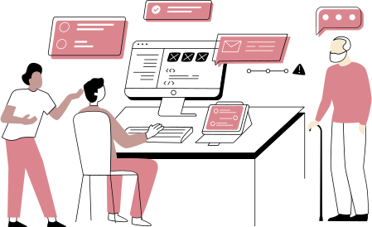



TECHNOLOGY STACK
PYTHON
Core language for chatbot logic and user interaction.
LIBRARY
Used for varied responses to keep conversations natural.
Future development could include natural language processing for more nuanced responses.

Slide 8


FUTURE DEVELOPMENT
SENTIMENT ANALYSIS
Incorporate sentiment analysis to improve response accuracy and sensitivity.
PLATFORM EXPANSION
MOOD TRACKING
Adapt the chatbot for integration on messaging platforms like WhatsApp or as a mobile app.
Enable users to log daily mood entries, which the chatbot can reference in future chats.
RESOURCE RECOMMENDATIONS
Offer links to mental health articles, hotlines, or professional resources.

Slide 9

DEMONSTRATION
SAMPLE INTERACTION
Chatbot: "What's your name?"
User: "Unathi."
Chatbot: "Nice to meet you, Unathi! How can I help you today?"
User: "I'm feeling sad."
Chatbot: "I'm sorry to hear that you're feeling this way. What's been bothering you lately?"
LIVE DEMO
Show the chatbot in action by typing in phrases related to mental health (e.g., "I'm stressed") and displaying its responses.

Slide 10


IMPACT & CONCLUSION
WHY THIS MATTERS
This chatbot serves as a low-barrier entry point to mental health support, encouraging users to acknowledge and address their feelings.
SOCIAL IMPACT
By offering a non-judgmental space, the chatbot aims to reduce the stigma around mental health and provide users with immediate, actionable advice.
FINAL TAKEAWAY
The Mental Health Chatbot isn't a substitute for professional help but is a meaningful tool for anyone seeking. immediate support and understanding.

